Slide 1


COP 5725
School of Computer and Information Sciences
Research of Hive data warehouse
Yezehao Huai
PID:5965823
yhuai001@fiu.edu

Slide 2
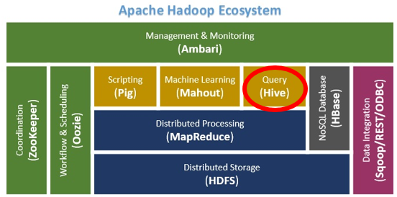
Introduction
Apache Hive is a data warehouse software project based on Apache Hadoop and HDFS for data query, summarization and analysis. Hive QL is a SQL-like declarative language to compile queries expression into Map-Reduce jobs executed on Hadoop.
Problems:
-44 x 10¹² gigabytes per day
-Focus on analysis results
-Need low cost of analysis, storage and high scalability database towards big data
-Map-Reduce is hard to learn and program for numerous users
Solution: Hive

Slide 3
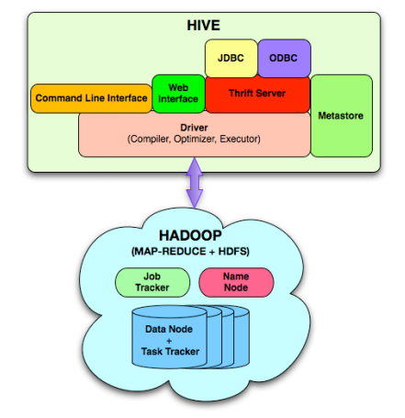
Elevator-Pitch
Principles
-Data warehouse concept
-Map-Reduce + HDFS
-Operating mechanism
Features & Optimization
-Hive vs Traditional database
-Hive QL
-Table Compression/Index/Execution Plan
Business Analysis
-Calculate the trend
-Analyze massive offline Web logs
-Web logs data warehouse

Slide 4
Deliverables
A research paper (25-35 references)
Time line (12 hours per week)
-Sep.23~Oct.6 : Proposal
-Oct.6~Oct.21 : Related work, technical principle research
-Oct.21~Nov.10 : Implementation of Hive
-Nov.10~Nov.23 : Final project report and experiment result
Contributions
-Related to my work
-Related to the Part 10(chapter 23, 24, 25) of course textbook
-Related to big data technical community

